Slide 1
MATLAB Programme to Analyze Time Modulated FSS

Slide 2
Introduction
Frequency-shifted reflection of electromagnetic waves is a technique that can be used to change the frequency of the reflected waves from a surface. This can be done by using a frequency-selective surface (FSS) that is tuned to a specific frequency. When an electromagnetic wave hits an FSS, it is either reflected or transmitted, depending on the frequency of the wave and the properties of the FSS.
The reflected EM wave from an FSS is modulated by applying a time-varying periodic biasing voltage across varactor diodes in the FSS. Variation in the bias voltage changes the reflection coefficient of the FSS and thereby modulates the reflected EM wave.
A prototype of the designed modulator surface is fabricated to verify the modulation performance experimentally.

Slide 3
What is FSS ?
Frequency-selective surfaces (FSSs) are artificially engineered surfaces that exhibit a frequency-dependent response to electromagnetic waves. This means that FSSs can be designed to reflect, transmit, or absorb electromagnetic waves of a specific frequency.
FSSs are typically made up of a periodic array of metallic or dielectric elements. The spacing between the elements is chosen so that the FSS resonates at a specific frequency. When an electromagnetic wave of the resonant frequency hits the FSS, it is either reflected or transmitted, depending on the properties of the FSS.
Time-modulated active tunable frequency-selective surface (TAM-FSS). The TAM-FSS is an FSS that is made up of varactor diodes. Varactor diodes are diodes that can have their capacitance changed by applying a voltage. This means that the frequency of the TAM-FSS can be changed by applying a time-varying voltage to the varactor diodes.
The basic principles of FSSs are used in a variety of applications, such as radar, communication, and imaging.

Slide 4
Significance of FSS
When a surface moves with respect to a radar receiver, the detected signal is shifted due to the Doppler effect. This shift can be used to track moving targets and measure their velocity.
To escape detection by a radar, microwave absorbing surfaces and materials are used to reduce the reflection from the surface. These absorbing materials can reduce the radar cross section (RCS) by several dBs over a specified range of frequencies.
However, an MTI or Doppler radar with higher sensitivity can still detect the object, even if the RCS is reduced.

Slide 5
How varactor diodes can be used to tune the frequency of an FSS ?
Varactor diodes are diodes that can have their capacitance changed by applying a voltage. This means that the frequency of an FSS that is made up of varactor diodes can be changed by applying a voltage to the varactor diodes.
The frequency of an FSS is determined by the spacing between the elements in the FSS. When an electromagnetic wave hits an FSS, it is reflected or transmitted, depending on the frequency of the wave and the spacing between the elements.
The spacing between the elements in an FSS can be changed by applying a voltage to the varactor diodes. This is because the capacitance of the varactor diodes changes with the voltage that is applied to them.
When the capacitance of the varactor diodes changes, the spacing between the elements in the FSS changes. This changes the frequency of the FSS, which can be used to tune the frequency of the FSS.

Slide 6
EM Wave Modulation
Modulation is the process of varying one or more properties of an electromagnetic wave in a controlled manner. The most common type of modulation is amplitude modulation (AM), in which the amplitude of the wave is varied. Another type of modulation is frequency modulation (FM), in which the frequency of the wave is varied.
The key here is to temporally modulate the reflection coefficient of a surface.

Slide 7



EM Wave Modulation
Let us consider an incident EM wave of frequency f_{i} , where the electric field on the surface is
If the FSS has a reflection coefficient Г(f),
then the reflected EM wave will be

Slide 8

EM Wave Modulation
The spectrum of the reflected light is obtained by the Fourier transform of the time-modulated reflection coefficient

Slide 9
Design of Time-Varying Reflection Coefficient

Slide 10
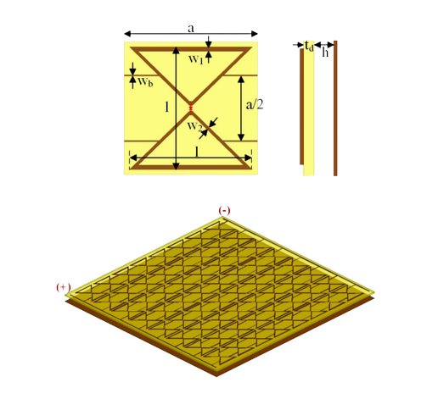
Geometry of the tunable active FSS
Top layer of the unit cell comprises two metallic triangular arms connected through a varactor diode. Arms of adjacent unit cells are connected through biasing lines. Such a dipole with triangular arms is chosen for its simplicity and ease of connecting biaslines. The metallic patterns are printed on an FR4 dielectric substrate of thickness t_{d} = 1.6 mm. An air spacer of thickness h = 6 mm separates the substrate and metal ground plane. The dimensions are a = 25 mm, l = 23 mm, w_{b} = 0.2 mm, w₁ = 0.8 mm, and w₂ = 0.57 mm. The varactor diode SMV 1249-079LF has a geometrical dimension of 1.2 × 0.7 mm².
Top Layer
Side View

Slide 11
Isometric View
Isometric view of 8 × 8 unit cells

Slide 12
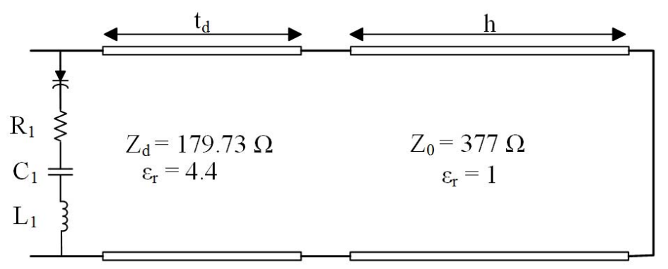
Equivalent circuit model of the tunable FSS.

Slide 13
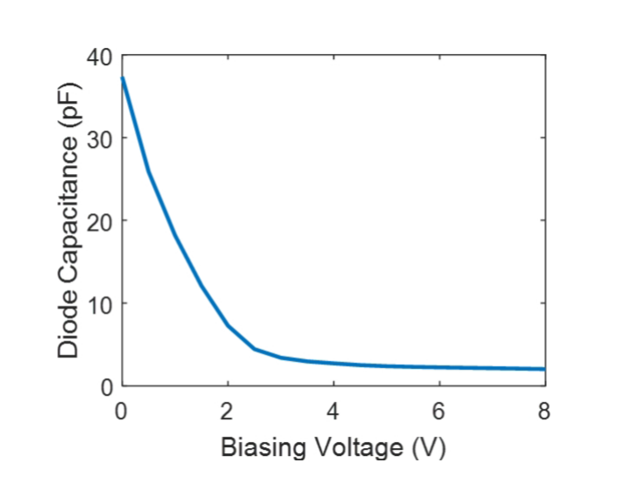
Relation Between the Capacitance and Volatage

Slide 14
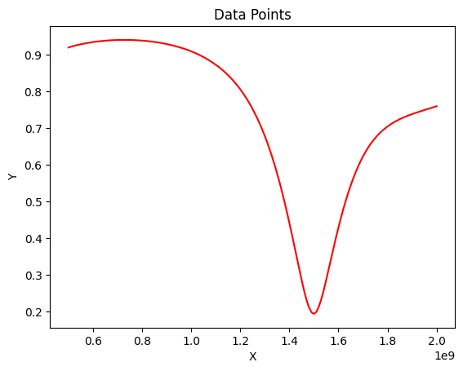
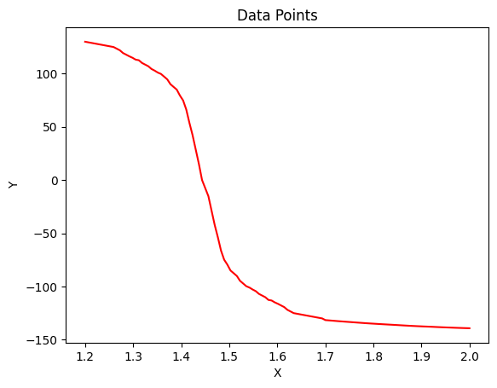
(a)
(b)
Equivalent circuit model of the tunable FSS.
(a) Magnitude, (b) Phase of the reflection coefficient.

Slide 15
Results And Observations I.) Sinusodial Biasing Voltage
II.) Saw-tooth Biasing Voltage

Slide 16
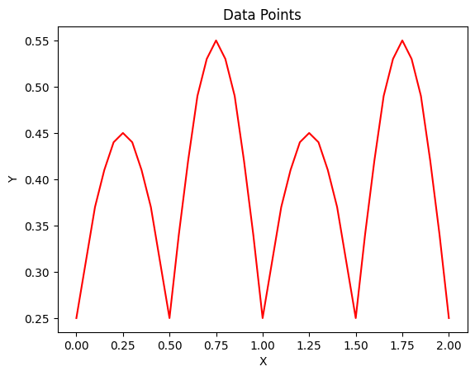
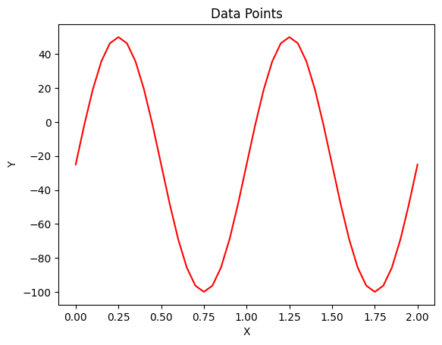
SINUSOIDAL BIASING VOLTAGE
Vb(t) = VB + vb*Sin(2*pie*fb*t) ; VB=2.6V; vb=1V; fb=1KHz

Slide 17
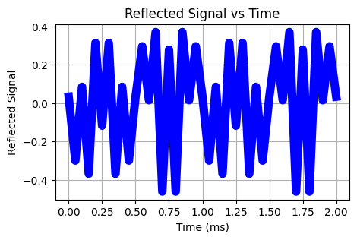
Reflected signal for applied saw-tooth biasing voltage.
Signal in the time domain.

Slide 18
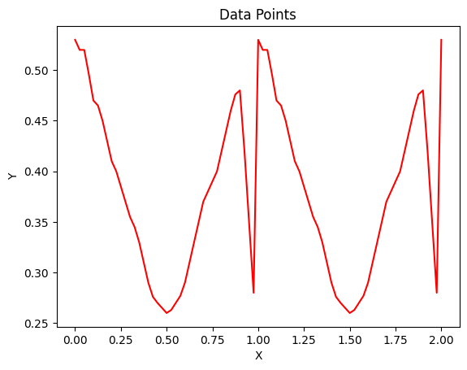
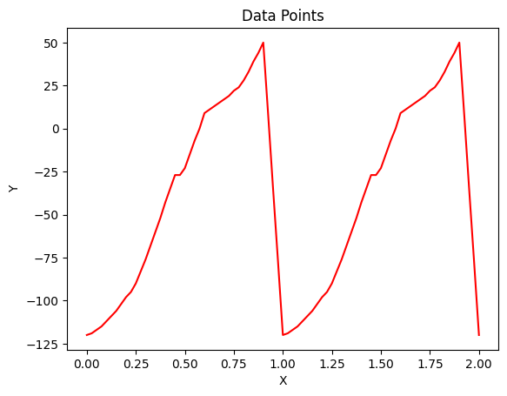
SAWTOOTH BIASING VOLTAGE
(a)
(b)
Variation in the reflection coefficient due to applied saw-tooth biasing voltage.
(a)Magnitude. (b) Phase of the reflection coefficient.

Slide 19
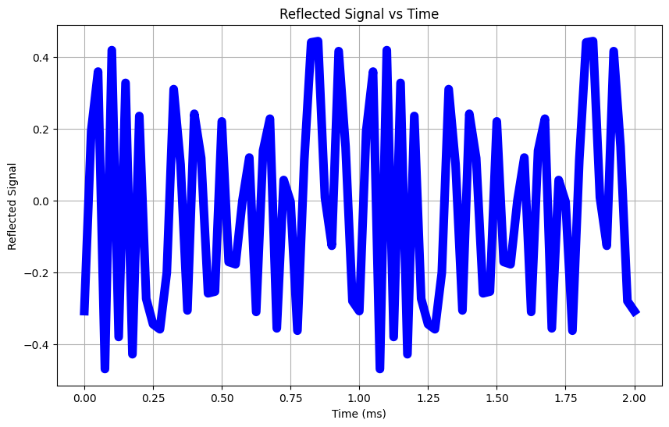
Reflected signal for applied saw-tooth biasing voltage.
Signal in the time domain.

Slide 20
Observation
# If we notice carefully we can see that for sinusodial biasing voltage, graphs of Phase vs Time and Magnitude vs Time are sinusodial.
# If we try to write the equations of Phase and Magnitude as function of time, we will get:
Magnitude(t) = 0.25 + 0.20*Sin(2*pie*t*fi) 0<=t<0.5 0.25 - 0.30*Sin(2*pie*t*fi) 0.5<=t<1
Phase(t) = -25 + 75*Sin(2*pie*t*fi) 0<=t<0.5
-25 + 100*Sin(2*pie*t*fi) 0.5<=t<1

Slide 21
Example
#If we consider a object covered with discussed technique moving with speed of sound and we consider sinusodial biaisng then it will generate multiple frequency components at 1KHZ apart.
# But it is to be noted that all these components will be shifted by doppler frequency(=(f*2*v*(1/c))) which in this case equals 3.54KHz
# So the radar will detect signals at 1.550002540, 1.550003540, 1.550004540 and so on with frequency component of 1.550003540 as less significant compared to other two
# Frequency components are 1KHZ apart because we choose hte value of fb = 1KHz in our model.

Slide 22
Conclusion
In this paper, we have presented a method for frequency-shifting the reflection of electromagnetic waves using a time-modulated active tunable frequency-selective surface (FSS). The proposed method is based on the use of varactor diodes to modulate the reflection coefficient of the FSS. By applying a time-varying bias voltage to the varactor diodes, the reflection coefficient of the FSS can be dynamically changed, which in turn causes the frequency of the reflected waves to be shifted.
The proposed method is a promising new technique for frequency-shifting the reflection of electromagnetic waves. It is relatively simple to implement and can be used to shift the frequency of the reflected waves over a wide range. The proposed method is also relatively efficient, as it does not require the use of any high-power amplifiers.

Slide 23
Thank You !

